Slide 1
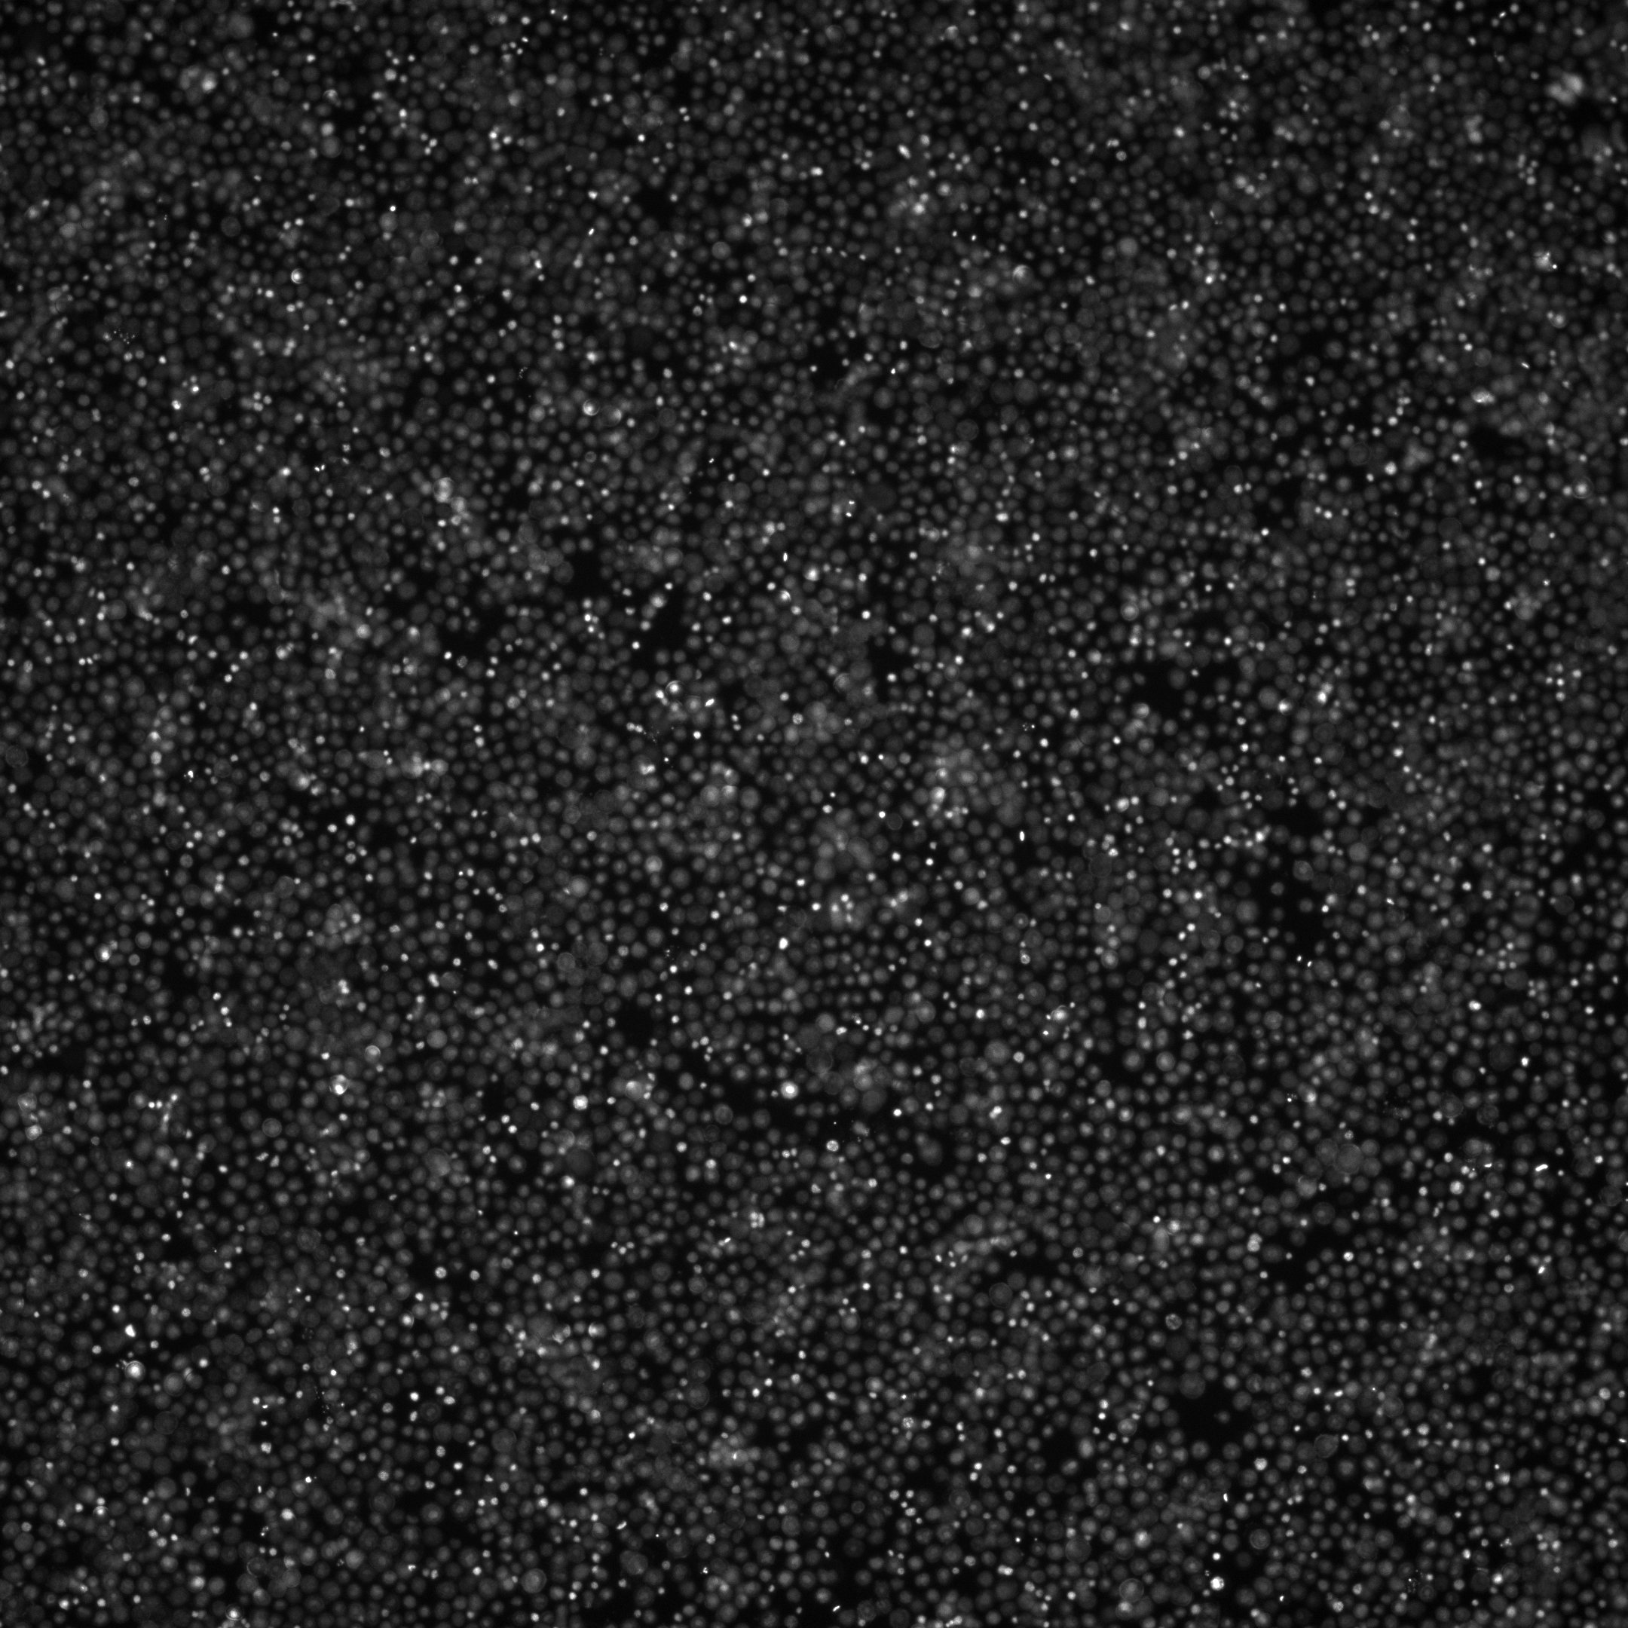
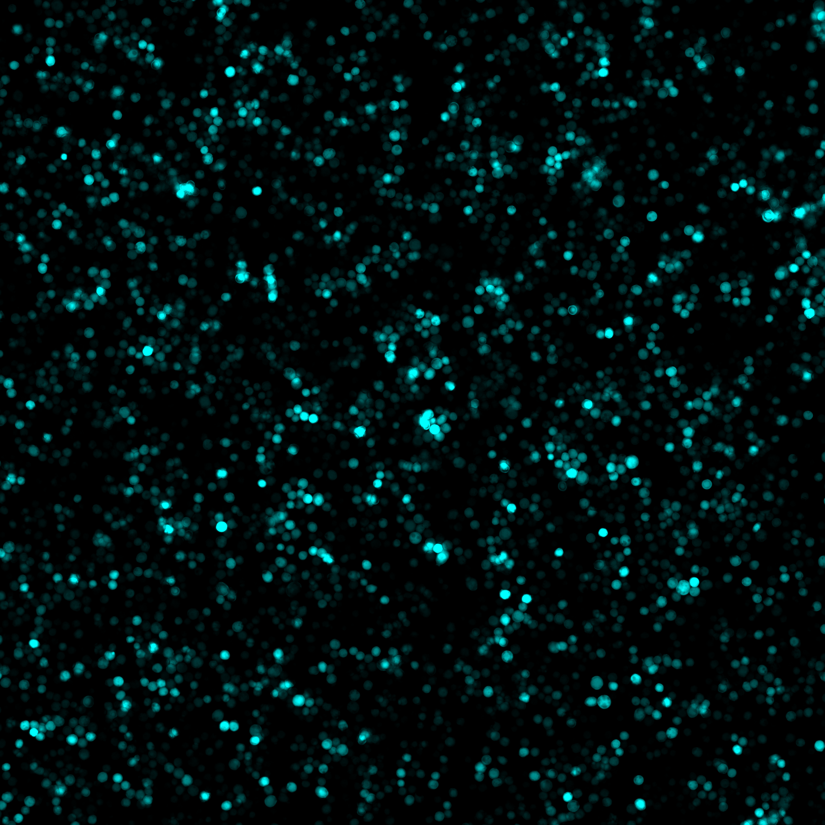
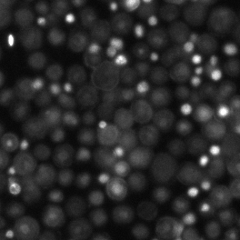

Representative Image from Well A01 (Highest MOI) – 36 HPI
Nuclei (Hoecsht)
Baculovirus-expressed GFP

Slide 2
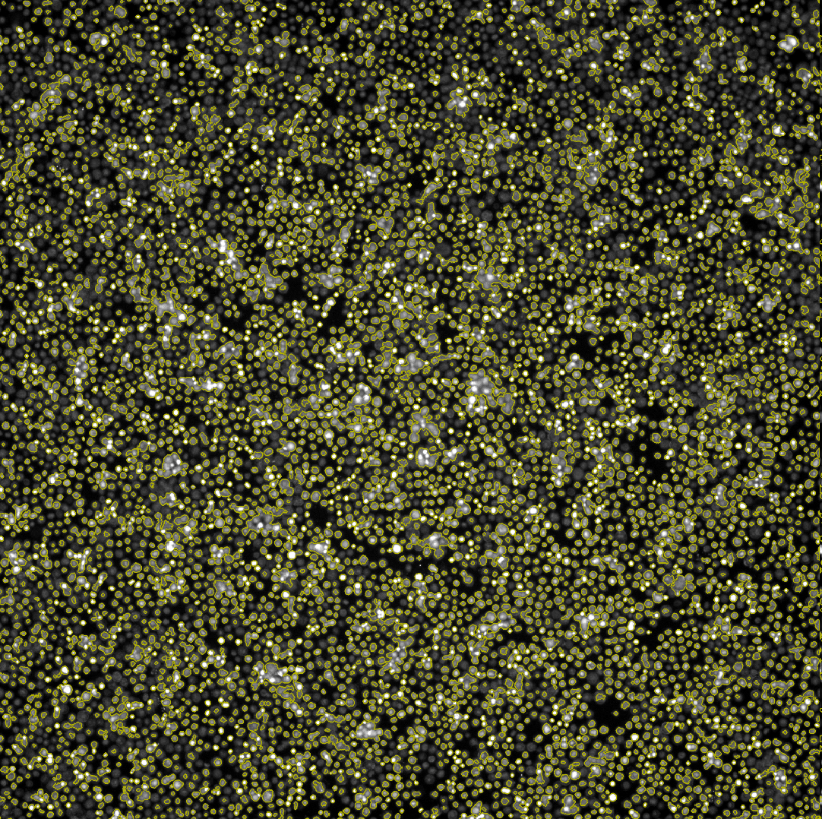
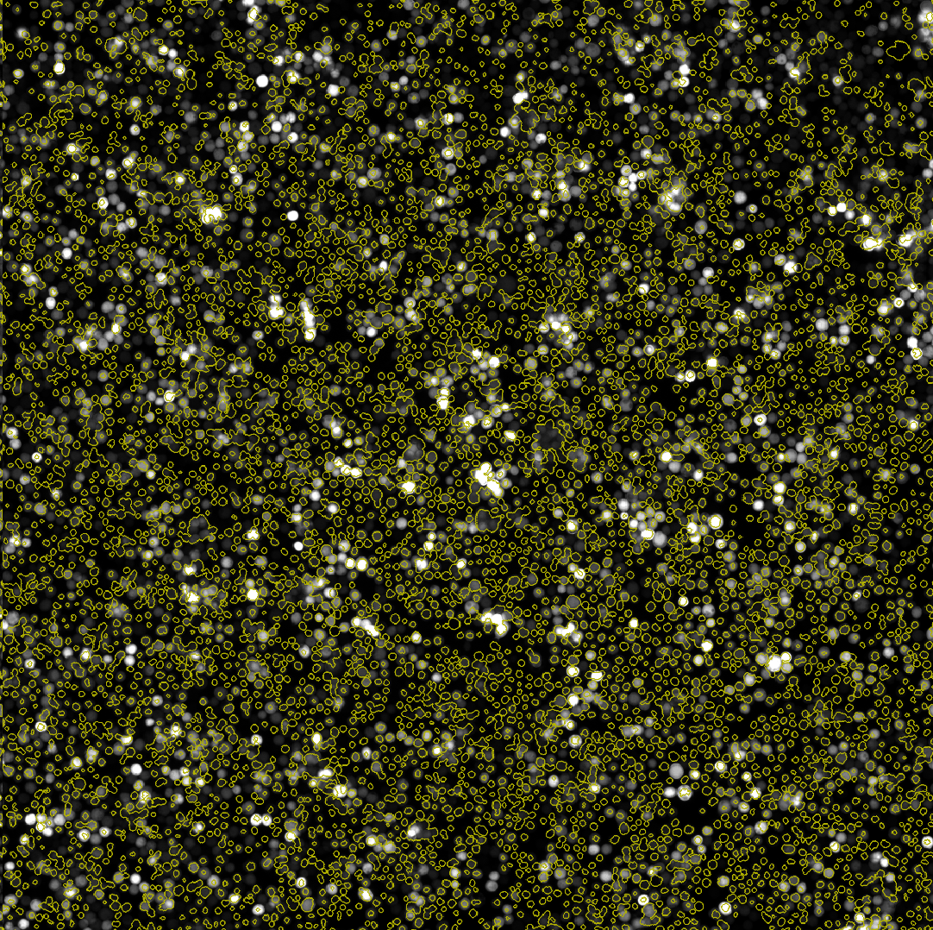
Image Analysis from Well A01 (Highest MOI) – 36HPI
Nuclei (Hoecsht)
Baculovirus-expressed GFP

Slide 3
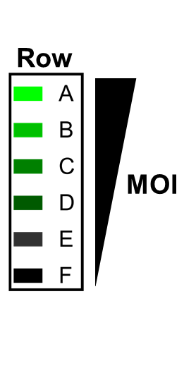
Mean Fluorescent Intensity (single cells) – Frequency Distribution
36 HPI
48 HPI
72 HPI

